Slide 2
Hands-on Machine Learning for Computer Vision
Insert session code here
Graeme Malcolm

Slide 3
Session learning objectives
At the end of this session, you should be better able to…
Train a deep learning model for image classification
Use Azure ML to deploy a machine learning model as a web service
Notes:
This slide is required. Do NOT delete. This should the first slide in your presentation after your session opening.
This slide should be part of your session opening and introduce what the learner will be better able to do as a result of attending this session.
You should have no more than 3 learning objectives for your session. Best practice: 1 Learning objective for 60 minute session. Aim for depth vs. breadth.
Good learning objectives should be learner centric, start with a verb (e.g., articulate, demonstrate, deliver, architect, troubleshoot, design) and be S.M.A.R.T (specific, measurable, achievable, realistic, time-bound). The learning objective should define a desired learner behavior (NOT what you are going to present).
The learning objectives on this slide should match those defined and published for your session on www.microsoftready.com. If you have questions, please contact your Track Content Lead.

Slide 4
Label
Features
y = f (x )

Slide 5
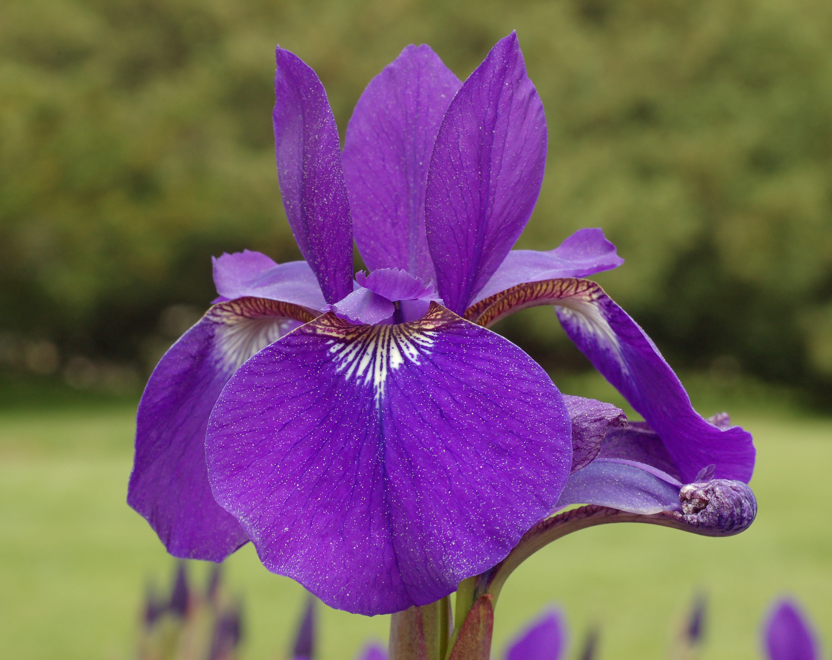
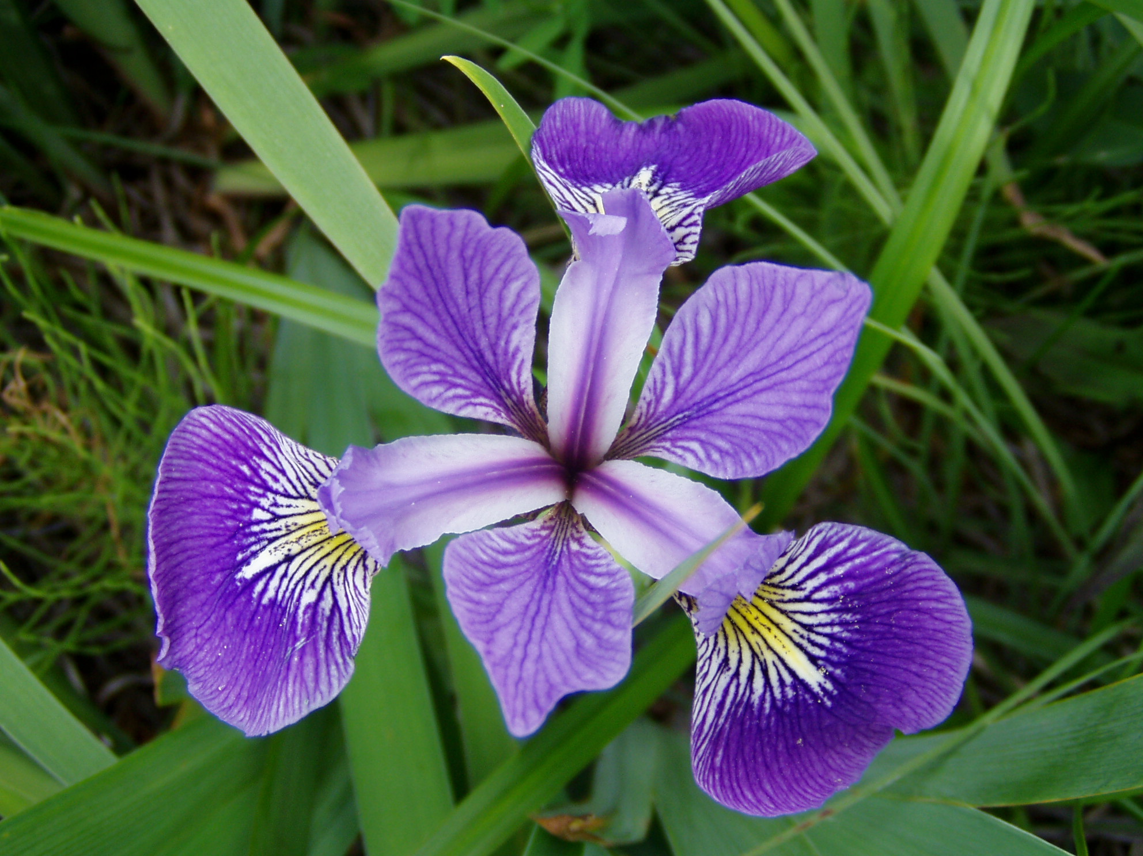
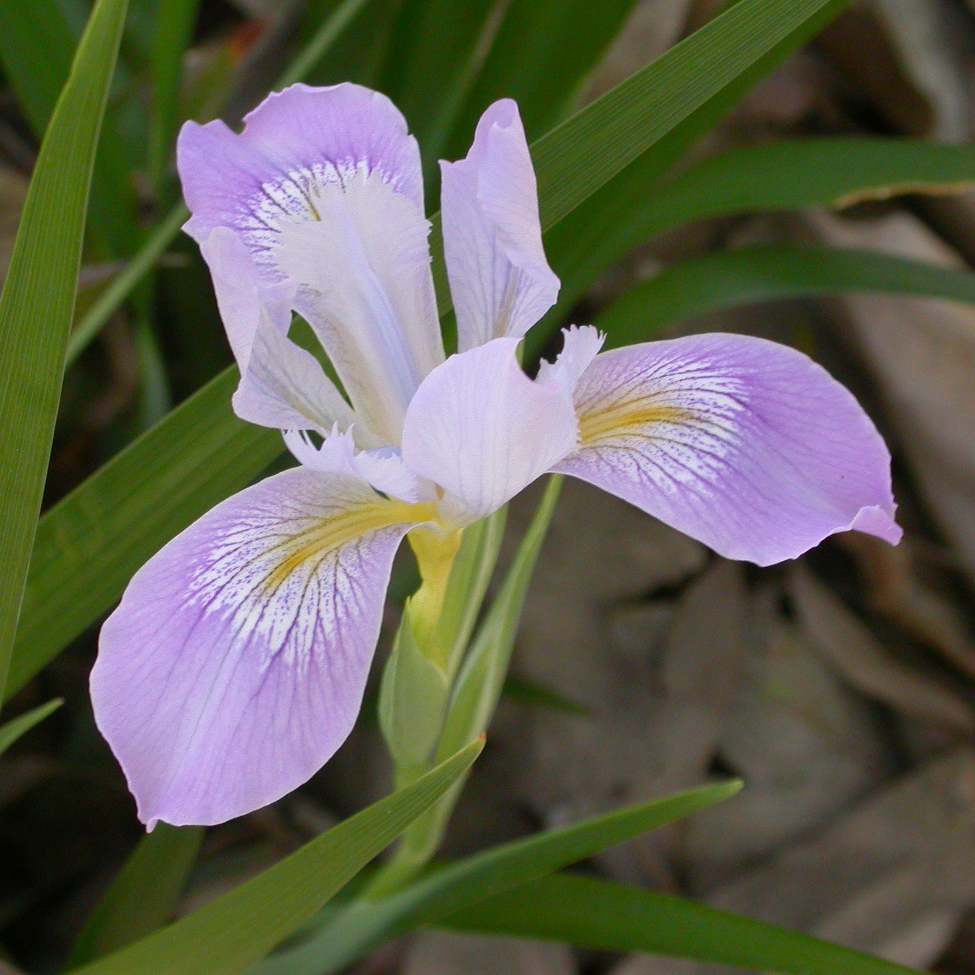
Species
Sepal / Petal Measurements
0 (“Setosa”)
1 (“Versicolor”)
2 (“Virginica”)
[6.6, 3.2, 5.8, 2.4]
y = f (x )
= [0, 1, 0]

Slide 6
b
w₁
x₁
y
∫
( )
f (x,w )
f (x,w,b )
x₂
∑
(xxw)+b
w₂

Slide 7
Neural Network (Perceptron)
6.6
3.2
5.8
2.4
∫∑(xw)+b
0.3
∫∑(xw)+b
∫∑(xw)+b
0.4
= [0.3, 0.4, 0.3]
∫∑(xw)+b
∫∑(xw)+b
[0.0, 1.0, 0.0]
0.3
∫∑(xw)+b
∫∑(xw)+b
Loss = 0.16
Loss = μ(0.3, 0.6, 0.3)²

Slide 8
1
Loss
0
1
2
3
w₁

Slide 9
Loss

Slide 10
Backpropagation
6.6
3.2
5.8
2.4
∫∑(xw)+b
∫∑(xw)+b
0.2
0.3
∫∑(xw)+b
∫∑(xw)+b
∫∑(xw)+b
∫∑(xw)+b
= [0.3, 0.4, 0.3]
0.7
= [0.2, 0.7, 0.1]
∫∑(xw)+b
0.4
∫∑(xw)+b
∫∑(xw)+b
[0.0, 1.0, 0.0]
∫∑(xw)+b
0.1
0.3
∫∑(xw)+b
∫∑(xw)+b
∫∑(xw)+b
∫∑(xw)+b
Loss = μ(0.2, 0.3, 0.1)²
Loss = 0.04

Slide 11
Training
Backpropagation
Validation
5.2
1.2
4.7
2.1
6.6
3.2
5.8
2.4
6.1
2.4
4.6
1.9
2.1
0.8
7.1
2.3
∫∑(xw)+b
∫∑(xw)+b
0.1
0.2
0.0
0.6
0.0
0.0
0.8
0.1
∫∑(xw)+b
∫∑(xw)+b
∫∑(xw)+b
∫∑(xw)+b
Loss = μ([c₁, c₂, c₃],…)²
0.0
0.7
1.0
0.2
0.0
0.1
∫∑(xw)+b
0.1
0.0
∫∑(xw)+b
∫∑(xw)+b

∫∑(xw)+b
0.0
0.1
0.0
0.2
1.0
0.9
0.1
0.0
∫∑(xw)+b
∫∑(xw)+b
∫∑(xw)+b
∫∑(xw)+b

Slide 12
x
w
b
6.6
3.2
5.8
2.4
6.1
2.4
4.6
1.9
2.1
0.8
7.1
2.3
0.6
0.3
0.4
0.9
0.1
0.2
0.1
0.3
x
+

Slide 13
0 | 0 | 0 | 0 | 0 | 0
0 | 3 | 2 | 2 | 3 | 0
0 | 0 | 2 | 2 | 0 | 0
0 | 0 | 2 | 2 | 0 | 0
0 | 3 | 2 | 2 | 3 | 0
0 | 0 | 0 | 0 | 0 | 0
∫∑(xw)+b
0 | 0 | 0 | 0 | 0 | 0
0 | 3 | 2 | 2 | 3 | 0
0 | 0 | 2 | 2 | 0 | 0
0 | 0 | 2 | 2 | 0 | 0
0 | 3 | 2 | 2 | 3 | 0
0 | 0 | 0 | 0 | 0 | 0
0 | 0 | 0 | 0 | 0 | 0
0 | 3 | 2 | 2 | 3 | 0
0 | 0 | 2 | 2 | 0 | 0
0 | 0 | 2 | 2 | 0 | 0
0 | 3 | 2 | 2 | 3 | 0
0 | 0 | 0 | 0 | 0 | 0
1.0
0 | 0 | 0 | 0 | 0 | 0
0 | 3 | 2 | 2 | 3 | 0
0 | 0 | 2 | 2 | 0 | 0
0 | 0 | 2 | 2 | 0 | 0
0 | 3 | 2 | 2 | 3 | 0
0 | 0 | 0 | 0 | 0 | 0
∫∑(xw)+b
∫∑(xw)+b
0.0
∫∑(xw)+b
∫∑(xw)+b
0.0
∫∑(xw)+b
∫∑(xw)+b

Slide 14
Convolution
0 | 0 | 0 | 0 | 0 | 0
0 | 3 | 0 | 0 | 3 | 0
0 | 0 | 2 | 2 | 0 | 0
0 | 0 | 2 | 2 | 0 | 0
0 | 3 | 0 | 0 | 3 | 0
0 | 0 | 0 | 0 | 0 | 0
1 | 0 | 0
0 | 1 | 0
0 | 0 | 1
5
2
0
3
2
7
2
0
0
2
7
2
3
0
2
5

Slide 15
Pooling (Downsampling)
0 | 0 | 0 | 0 | 0 | 0
0 | 5 | 2 | 0 | 3 | 0
0 | 2 | 7 | 2 | 0 | 0
0 | 0 | 2 | 7 | 2 | 0
0 | 3 | 0 | 2 | 5 | 0
0 | 0 | 0 | 0 | 0 | 0
7 | 7 | 7 | 3
7 | 7 | 7 | 7
7 | 7 | 7 | 7
3 | 7 | 7 | 7
7 | 7 | 7 | 3
7 | 7 | 7 | 7
7 | 7 | 7 | 7
3 | 7 | 7 | 7
7

Slide 16
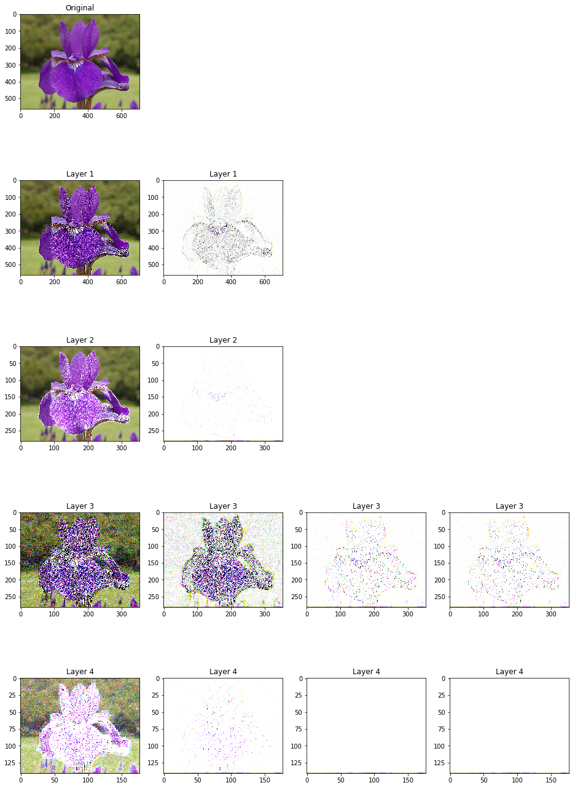
Convolutional Neural Network
0
0
0
0
3
2
0
0
2
∫∑(xw)+b
∫∑(xw)+b
0.8
0 | 0 | 0
0 | 3 | 2
0 | 0 | 2
∫∑(xw)+b
∫∑(xw)+b
0.2
0
0
0
0
3
2
0
0
2
∫∑(xw)+b
∫∑(xw)+b
0.0
0 | 0 | 0
0 | 3 | 2
0 | 0 | 2
∫∑(xw)+b
= [0.8, 0.2, 0.0]
Feature Extraction
Classification

Slide 17

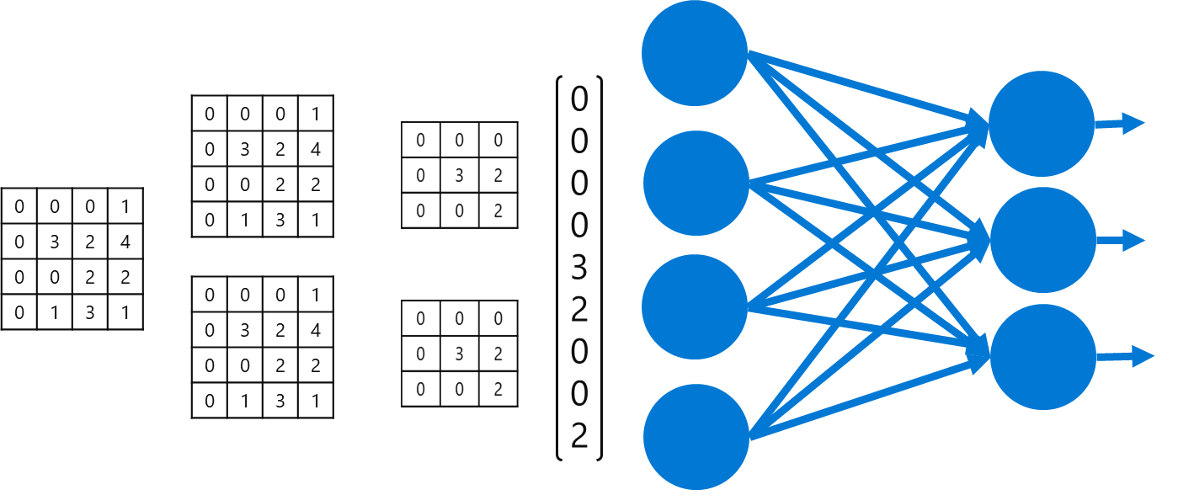

?
Setosa

Slide 18
Hack
https://aka.ms/ready2019-vision-hack

Slide 19
Session takeaways
Use convolutional neural networks for image classification
Use Azure Machine Learning for model training, management, and/or deployment
Notes:
This slide is required. Do NOT delete. This slide is required just prior to the “session resources” slide
SESSION TAKEAWAYS & ACTIONS: Bullet points highlighting the primary actions learners should take away or knowledge learners should recall to help them successfully perform in role (e.g. practical guidance, tips, suggested behavior changes.)
Please Note: Session Takeaways are not required for Group Discussions; however, takeaways should be captured real time by the facilitator during the session and those key points should be emphasized during the discussion or workshop. If you have questions, please contact your Track Content Lead.

Slide 20
Session resources
Notebooks at https://aka.ms/mlprimers
Microsoft Ready content can be found at https://digital.microsoftready.com/
Notes:
This slide is required. Do NOT delete. This slide is required at the end of your session to recap additional resources.
Use this slide to share additional available content that attendees can leverage after the event. In this section you can call out whitepapers, websites, communities, etc. that might be useful for the learner.

Slide 21
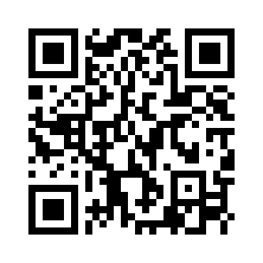
Evaluations can be submitted via:
Enjoy a session
Fill out an evaluation
Win a prize
Make MS Ready better
Laptop/Mobile
connect to Schedule Builder on www.microsoftready.com
Windows/Windows Phone
MS Ready App (Search “MS Ready” in the Store)
Your mobile device
scan the QR code to reach your evaluations
*If you plan to remain in this room for the next session, please be sure to scan your badge again at the door prior to the session starting

